Slide 1

Exam Lead Process
Amateur Radio License Exam
© 2025 WM7X.net

Slide 2
Sections
Tips for Practicing
Use Presenter Mode
    Windows: F5, Mac: ⌘+Enter
Click to advance slides
If you see Links…
      That means there’s a choice
Click a link to choose a path
Prepping an Applicant
Leading the Exam
Exiting an Applicant
General Notes

Slide 3
Prepping an Applicant
Instructions for the main room

Slide 4
Prepping an Applicant: Welcome!
What sort of device are you using today: Windows, Mac?
  If Mac, try sharing screen to see if permissions are set
Are you wearing a smart watch, ear buds, or smart glasses?
  Put smart watch out of reach
  Ear buds are OK until the exam begins
  Bluetooth Hearing Aids:
    Ask if comfortable removing them during the test process
    They can be in until the test, and afterwards
    If they are not OK with that, ask for help

Slide 5
Prepping an Applicant: ID
Ask to See ID
  We’d like to look at your government issued ID to ensure your name matches your registration
  A cohost will use the Zoom Spotlight tool to make the image bigger
  Name must match FRN info. Joe ≠ Joseph, Look for “Jr.” “III”, etc.
  Middle name/initial is optional
  Get thumbs up from the team

Slide 6
Prepping an Applicant: Second Device
We’d like you to join the meeting on your 2nd device
  You can use the link you were sent Or…
  Go to wm7x.net/zoom, click JOIN EXAM SESSION Or…
  If needed, the meeting ID is 509 800 7348, passcode: 7373
Host will move the device to a room and admit it
  2025-12-30: Zoom has a bug in which the device may come into the waiting room. If it does, ask to turn down the volume, then invite it to the test room
Great, now we’re going to set things up to avoid feedback
Is that an iPhone or Android device?

Slide 7
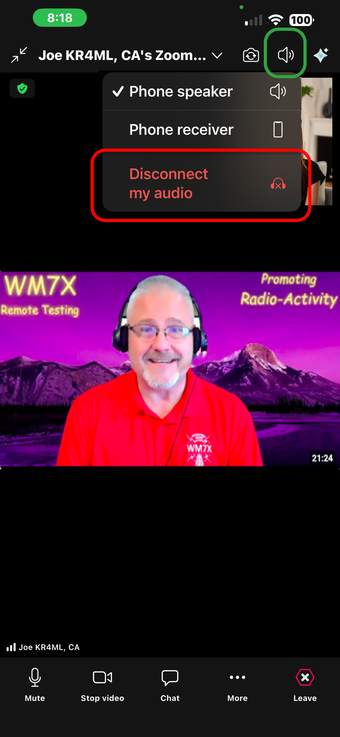
Disabling iPhone Audio
If you tap the screen, you’ll see a little
speaker icon near the upper right corner
Tap it, then tap Disconnect my audio
It will be red
If applicant reports no speaker icon, it’s an old version of
zoom. Follow the Android instructions
Host will check the breakout room window in Zoom to
ensure that audio has been disconnected
Continue

Slide 8
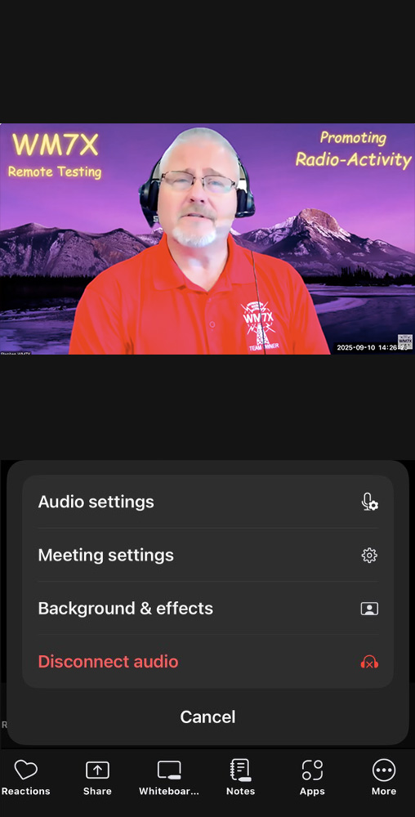
Disabling Android Audio
If you tap the screen, you’ll see some icons
across the bottom - tap More (3 dots)
May need to scroll to the right
Now tap the red Disconnect Audio button
May need to scroll down
Host will check the breakout room window in Zoom to
ensure that audio has been disconnected

Slide 9
Prepping an Applicant: Finalize
Do you have any questions for us?
Tell them they will receive an invite to a breakout room
  A zoom co-host will send an invite
We’re going to get our team together, and they will join you there in just a couple of moments

Slide 10
Leading the Exam
Instructions for the breakout room

Slide 11
Check ID
SKIP if done in the Main Room with other VEs present
Ask to see ID
  We need to make sure your name matches your registration
  Name must match FRN info. Joe ≠ Joseph, Look for “Jr.” “III”, etc.
  Middle name/initial is optional
  Get thumbs up from the team

Slide 12
Recording
Bring up Participants and Chat Panels
  Windows: Alt+U, Alt+H Mac: ⌘+U, ⌘+⇧+H
Wait for “recording in progress” message
  If none, ask recorders to begin
  Confirm: three recorders (red dots) in Participants window
  Remember: The Lead (you) always performs R1
Consent
  Would you please give us your verbal consent to record the session?
  You may have a pop-up about that, you can close it

Slide 13
Check Wearables
SKIP if done in the Main Room with other VEs present
Smart devices
  Ask about earbuds and smart watches
  Check for smart glasses (e.g. Meta or Google)
Bluetooth Hearing Aids
  Ask if comfortable removing them, just during the actual test process
  They can be until the test begins, then back in after
  If not, call for help to find a different way to administer the exam

Slide 14
Room Scan
Sweep around room, slowly, at eye level
  Get view of any smart devices (e.g. watch) placed out of reach
  Address issues as needed
Ask to see the full desk surface
  Address issues as needed
If using paper, ask to see both sides
Get a thumbs-up from the team

Slide 15
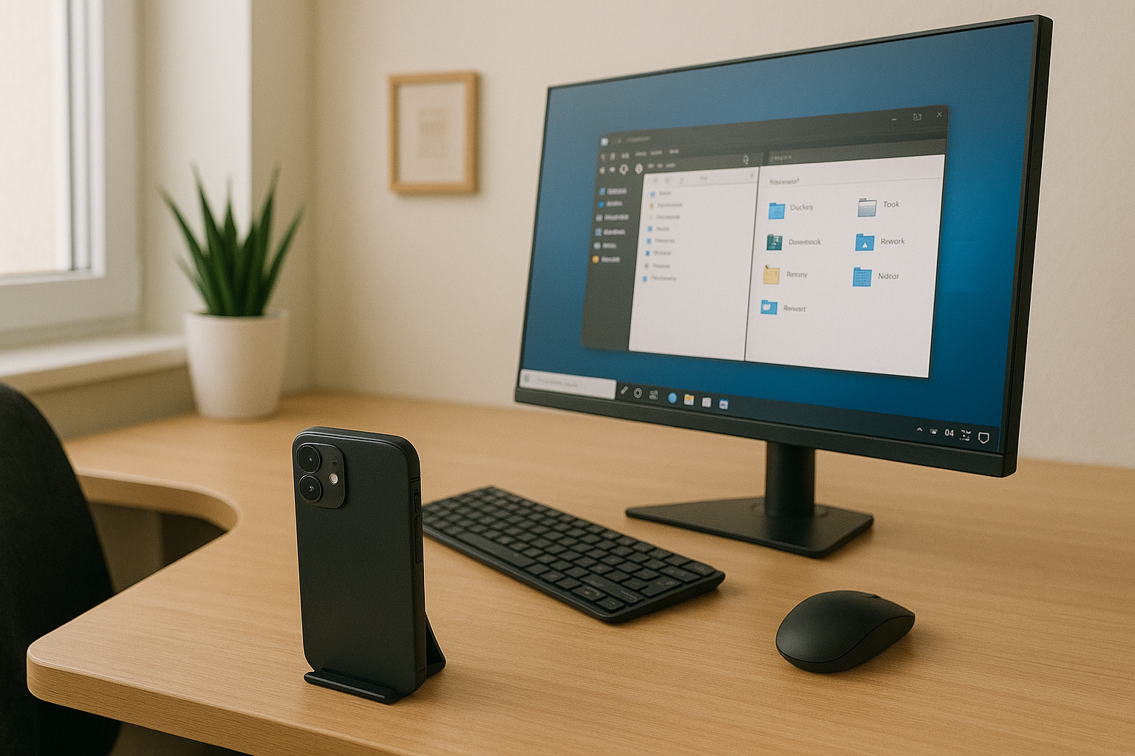
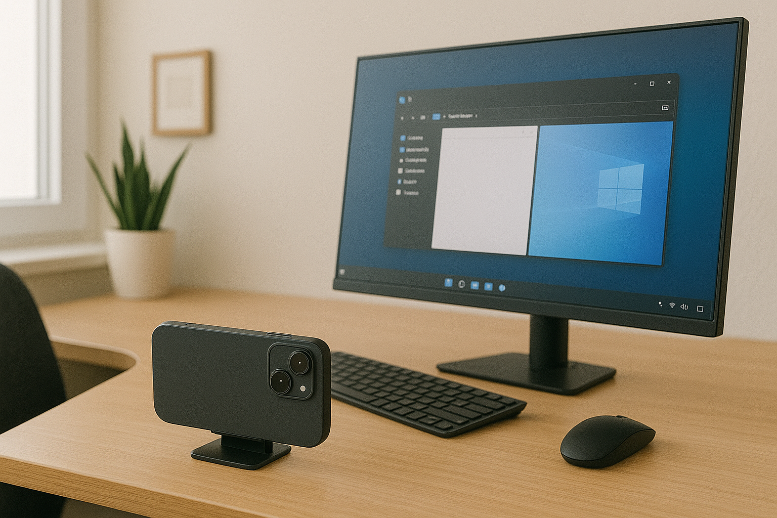
Prop Up 2nd Device
We’d like you to find a spot for your phone where it has a good view of your computer screen, and prop it up there
Work with the applicant to find a position that provides a clear view of the display
  Place the phone in landscape orientation if it works better
  Potentially use rear-camera
Make sure R3 is OK with the view

Slide 16
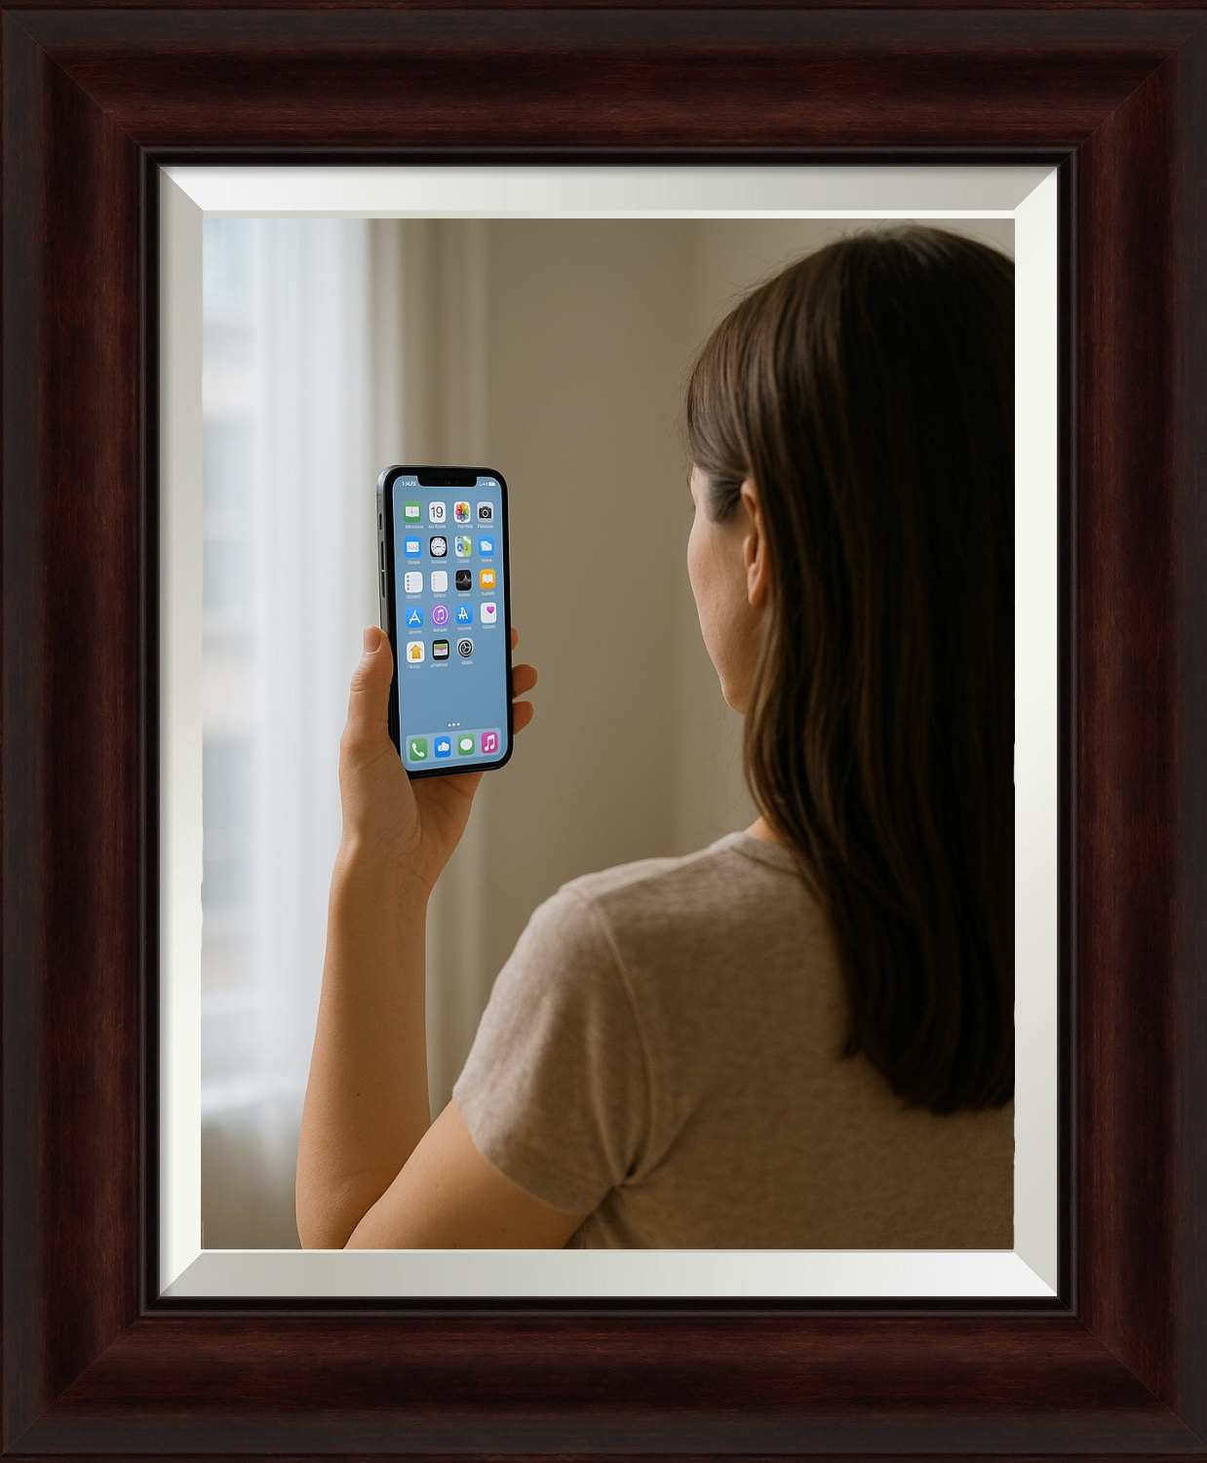
If No Second Device (Rare)
If no 2nd device, the applicant must test in
front of a mirror so we can see their screen
We’d like you to go into a room with a mirror, and put your back to it
We’ll be able to see your screen in the reflection, and we’ll be good to go!
Guide them through the setup

Slide 17
What type of device?
Mac
PC
iPhone/iPad
Android
ChromeBook
Linux

Slide 18
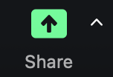

ChromeBook: Start Sharing
Please be sure not to close your Zoom tab!
Press the green Share button with up arrow at
the bottom of Zoom tab
Now Press the blue Share button at the bottom
of the new window that just popped up

Slide 19
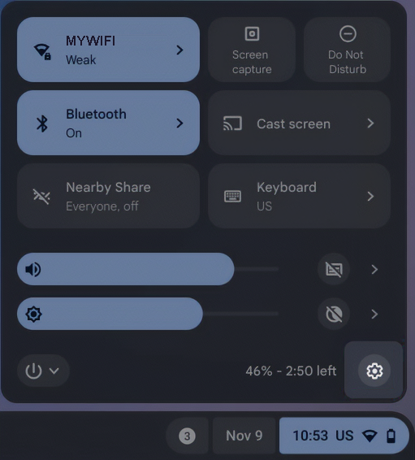
ChromeBook: Check “Casting”
Ask the user to click the Date/Time in the lower right of the screen
Look for the Cast Screen button. If it says Casting, ask the user to click again to stop the screen-cast
Notes:
  Different versions of ChromeOS may look slightly different. Look for the button that mentions Cast
  If in doubt, check Settings (⚙) → Device → Displays. It will show an external display if it is casting.

Slide 20
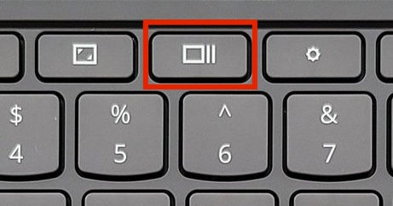
ChromeBook: Desktops and Apps
Show Windows and Desktops
  Close all apps except Chrome and Zoom (if running as a separate app)
  Close all but the main desktop
Continue to Browser Setup

Slide 21
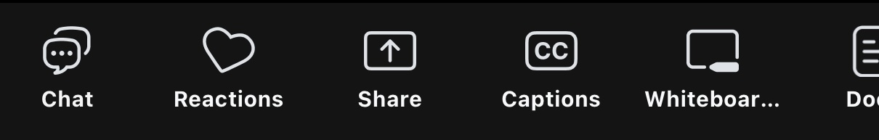
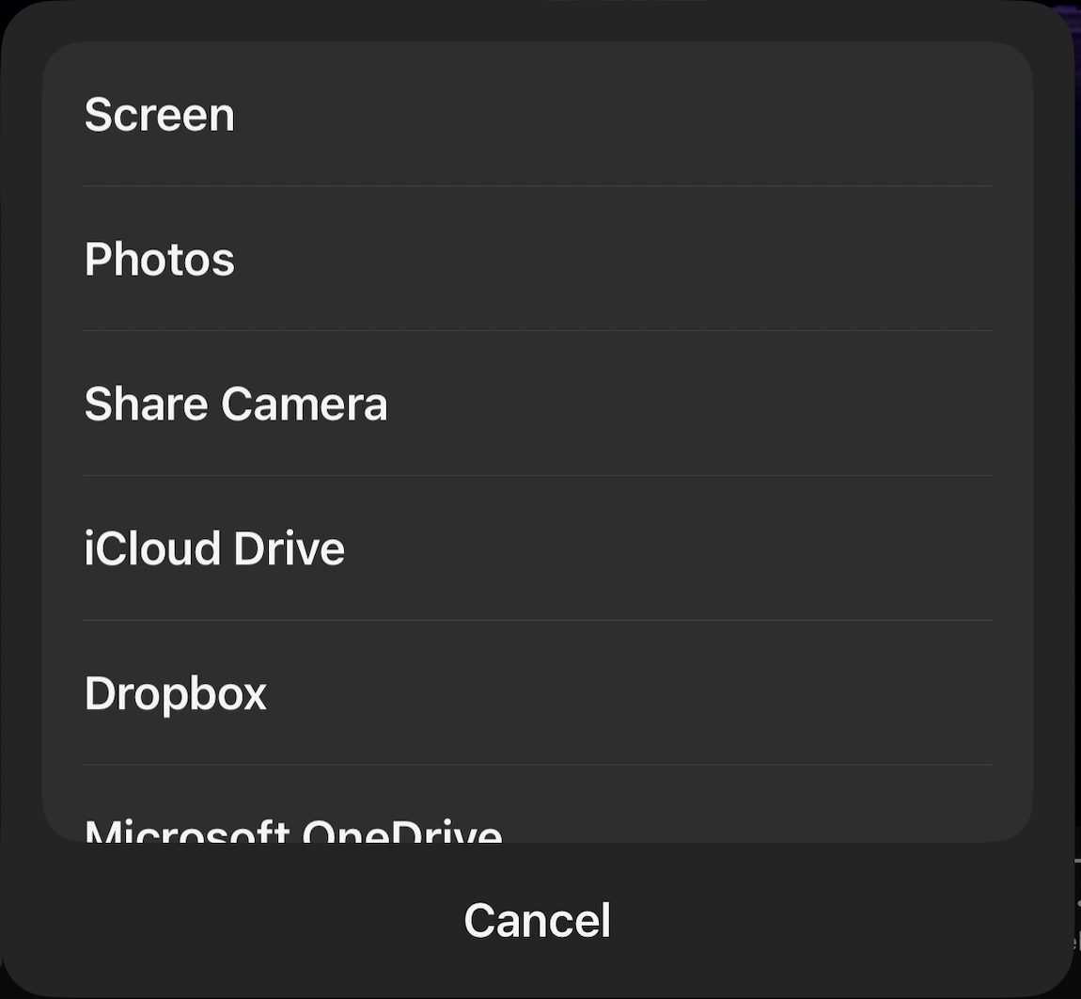
iPhone/iPad: Start Sharing
In the Zoom app at the bottom, tap Share.
  If they don’t see it, they might have to
  swipe the buttons to the left to show it
Now tap the Screen button at the top of the list
Finally, tap Start Broadcast, then return
to the home screen

Slide 22
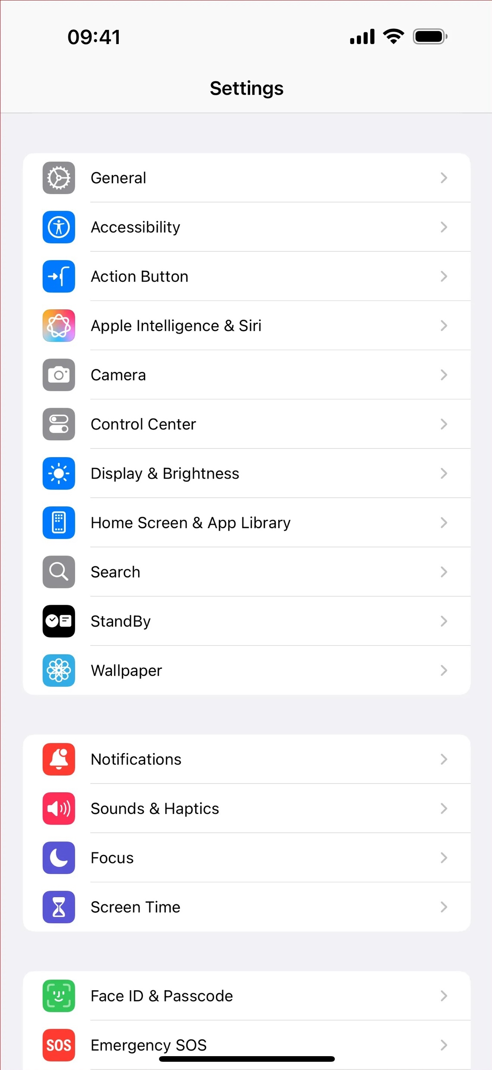
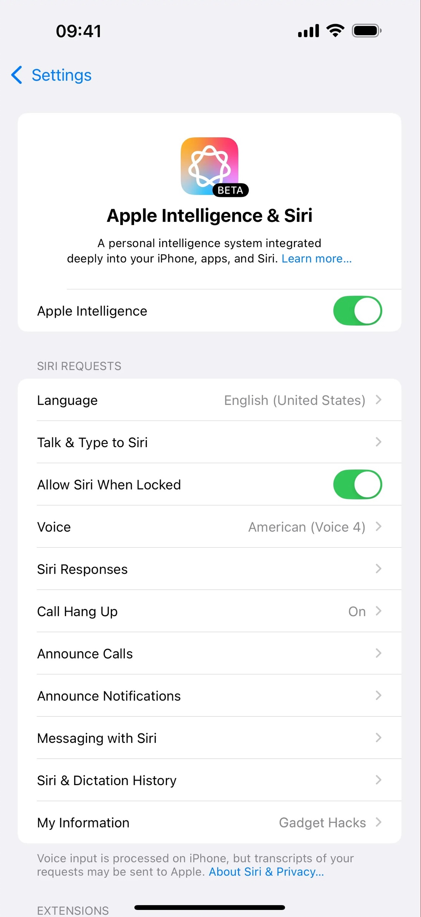
iPhone/iPad: Apple Intelligence
Settings → Apple Intelligence & Siri (If just “Siri”, skip)
Turn off if enabled

Slide 23
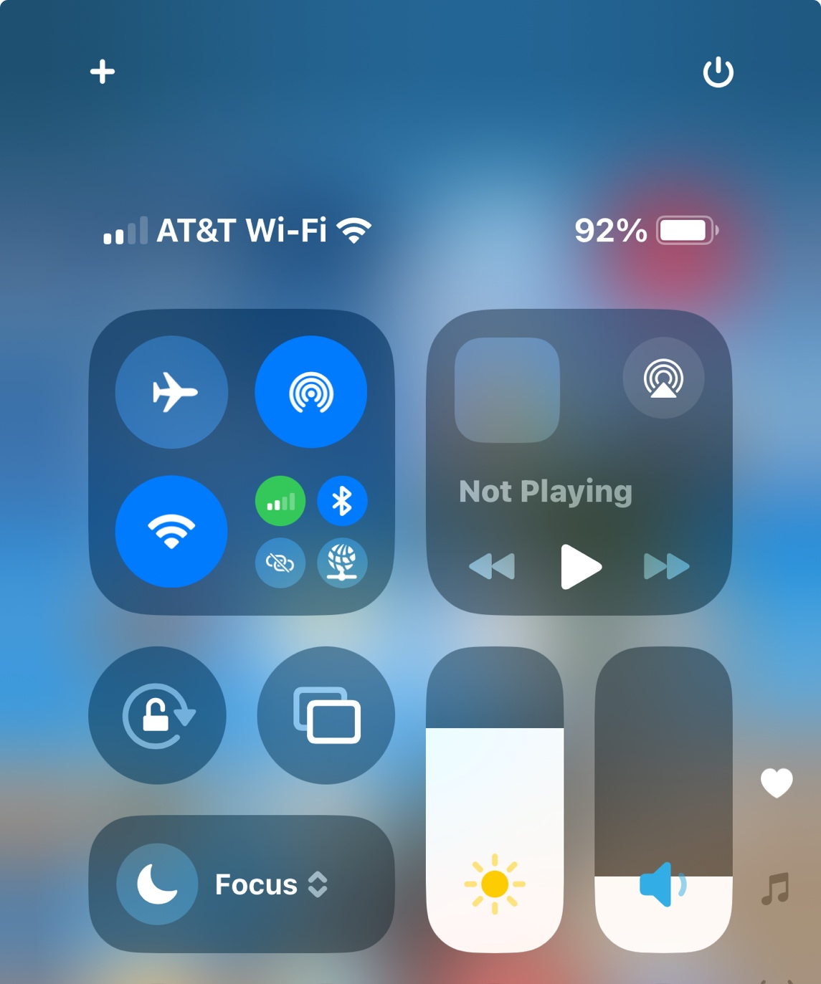
iPhone/iPad: Apps & Mirroring
Home Screen → Swipe Up halfway* to reveal running apps
  Please be sure not to close anything that says Zoom!
  Quit all apps other than Zoom and the Browser
  Return to home screen
Home Screen → Swipe Down from
top right for Screen Mirroring
  Stop mirroring if needed
Continue to Browser Setup
* Old devices may have a home button (double tap)
Notes:
We stop mirroring so they can’t send their screen to someone else who would look up answers

Slide 24
Mac: Start Sharing
Press the green Share button with up arrow at
the bottom of Zoom window
  If they don’t see it, they might have to click on the zoom
  window to make it appear
Now Press the blue Share button at the bottom
of the new window that just popped up

Slide 25
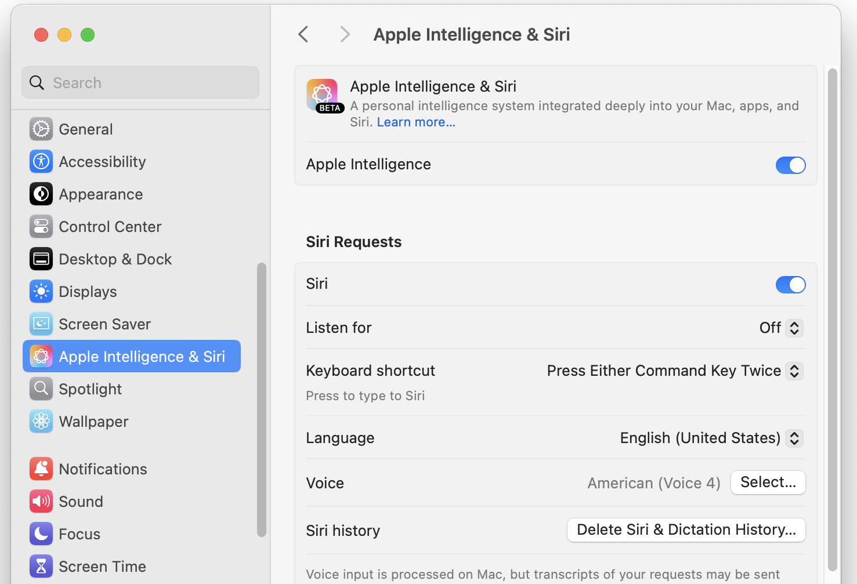
Mac: Apple Intelligence
Apple Menu → System Settings (or Preferences)
Check for Apple Intelligence and turn off
Close System Settings

Slide 26
Mac: Running Apps
Apple Menu → Force Quit
  Quit all apps other than Zoom and the Browser
  Remind them to save any open files before quitting
  Close Force Quit window
Check menu bar items
  Hover over each and close if needed
  Look for things like screen sharing apps and chat apps
Notes:
We stop mirroring so they can’t send their screen to someone else who would look up answers

Slide 27
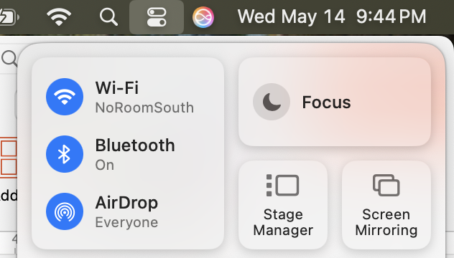

Mac: Screen Mirroring and Desktops
Open Control Center from Menu Bar
  Check Screen Mirroring status
  Turn off if needed
Hold down CTRL and press the Up-Arrow (or use F3)
  Check for one desktop, no stray apps, close as needed
  ESC to return
Continue to Browser Setup

Slide 28
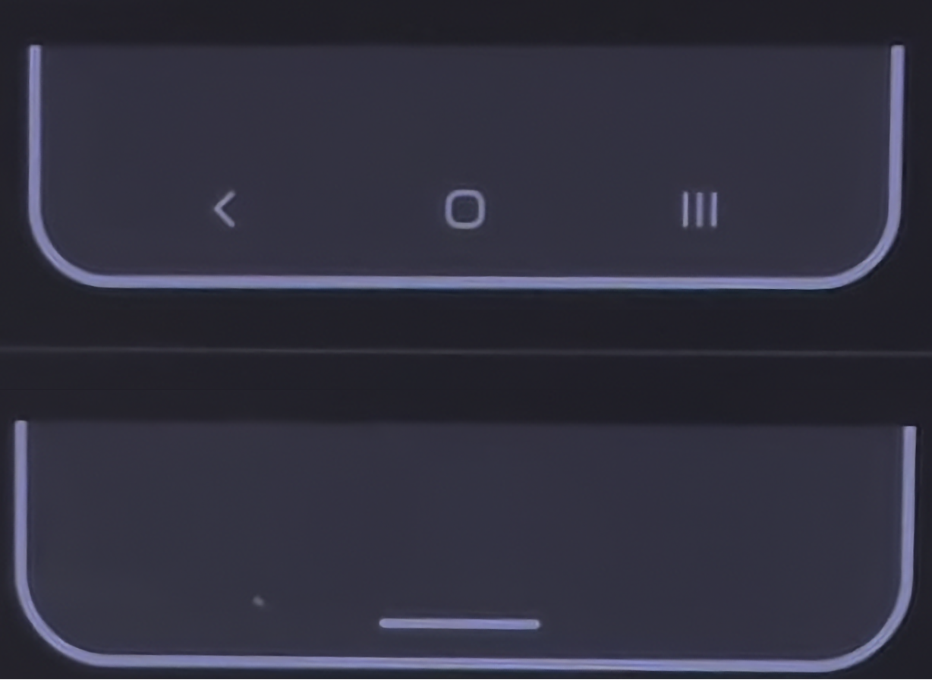
Android: Get Oriented (optional)
First off, would you help me get oriented to your phone?
At the bottom there might be 3 icons, or just a white line
Thank you! That will help me guide
you through this
During the process, if you get pop-ups
you don’t recognize, let me know and
we’ll work through them.
Notes:
NOTE ABOUT BLUR: Could be in 2 places
In Zoom Tap “More”, then scroll to “Background and Filters. Tap that and choose “None”
Still blurred?
* Ask if they are using a Samsung phone
* If so, have them swipe down once from the top of the screen, then swipe down again to enter “quick settings” / “control center”
* They will see a video effects option option. Tap that, then tap “Background” and “None”

Slide 29
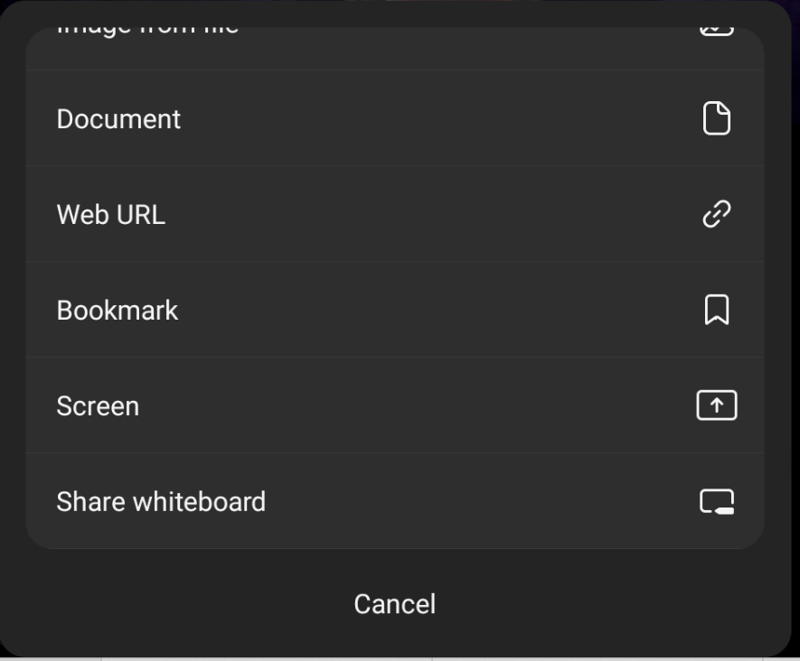
Android: Start Sharing (1/2)
In the Zoom app at the bottom, tap Share.
  If they don’t see it, they might have to
  tap my picture, then possibly swipe
  the buttons to the left to show it
To share the full screen, tap the Screen
button toward the bottom of the list
A new pop-up will appear…
  Choose START NOW to begin sharing
Let me know if you’re asked for permission…

Slide 30
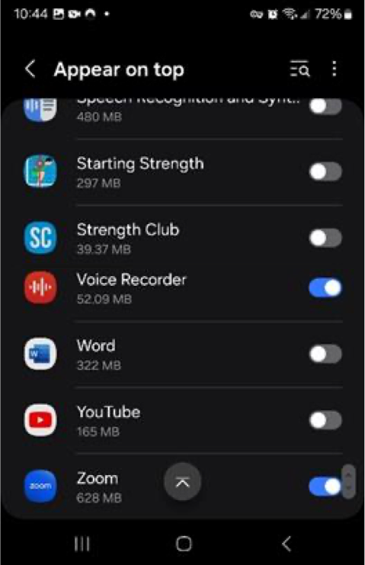
Android: Start Sharing (2/2)
If asked for permission…
  They must allow Zoom to run on top of other apps
  Scroll to the bottom of the list to find Zoom
  Flick the switch to enable Zoom
  Tap the left arrow at the top of the screen
  Ask to start their video again
    Click the Movie Camera (Video) icon in Zoom

Slide 31
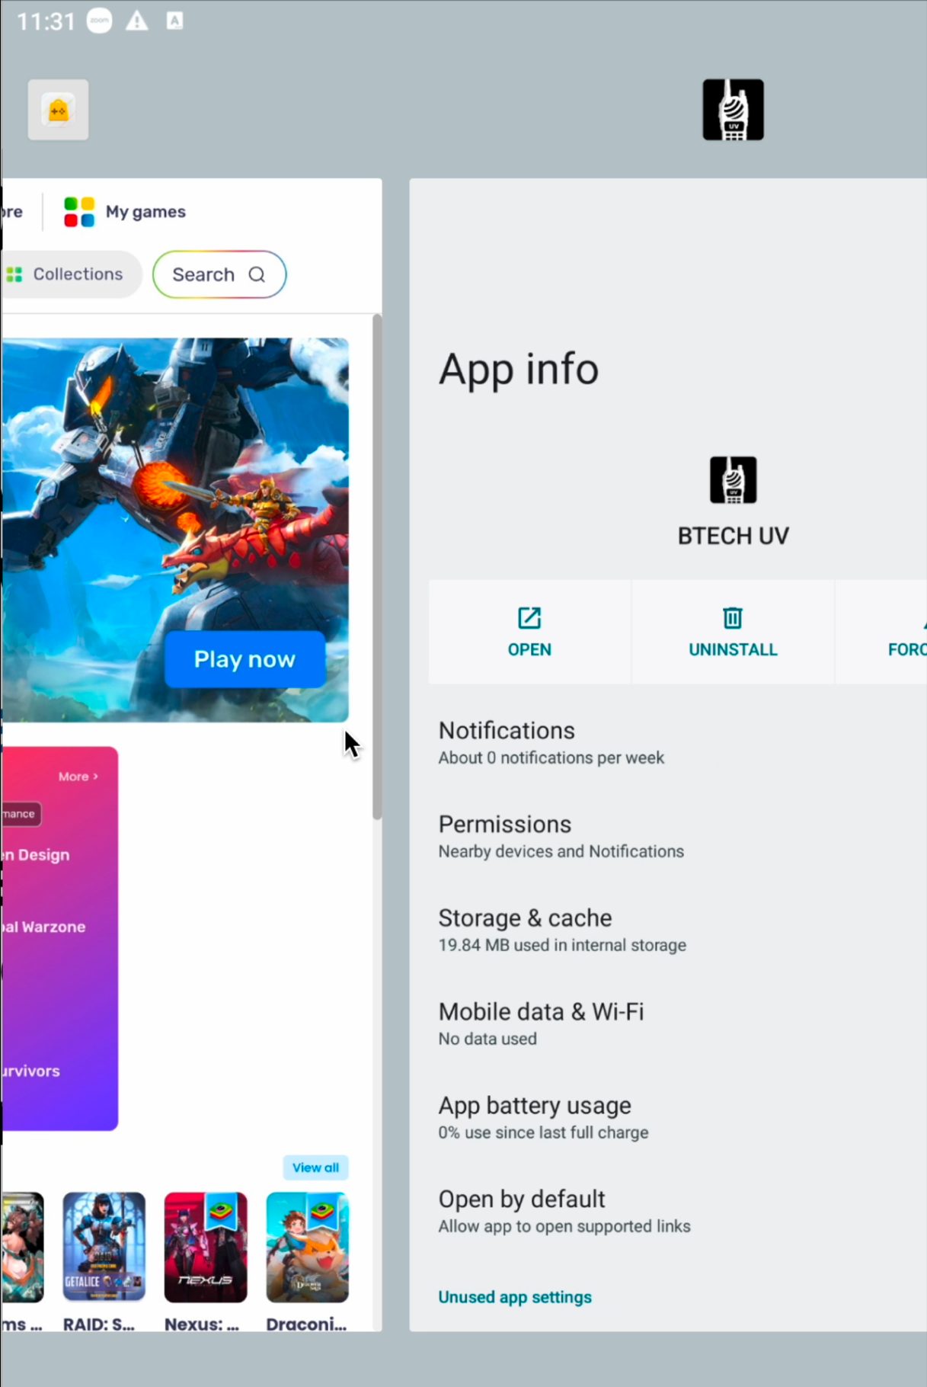
Android: Terminate Other Apps
Show the app-switcher using the three-line icon or by swiping up halfway on the gesture bar (white line)
Be careful, don’t close Zoom!
Close everything except Zoom by swiping the unneeded apps up and off the screen
Return to the home screen

Slide 32
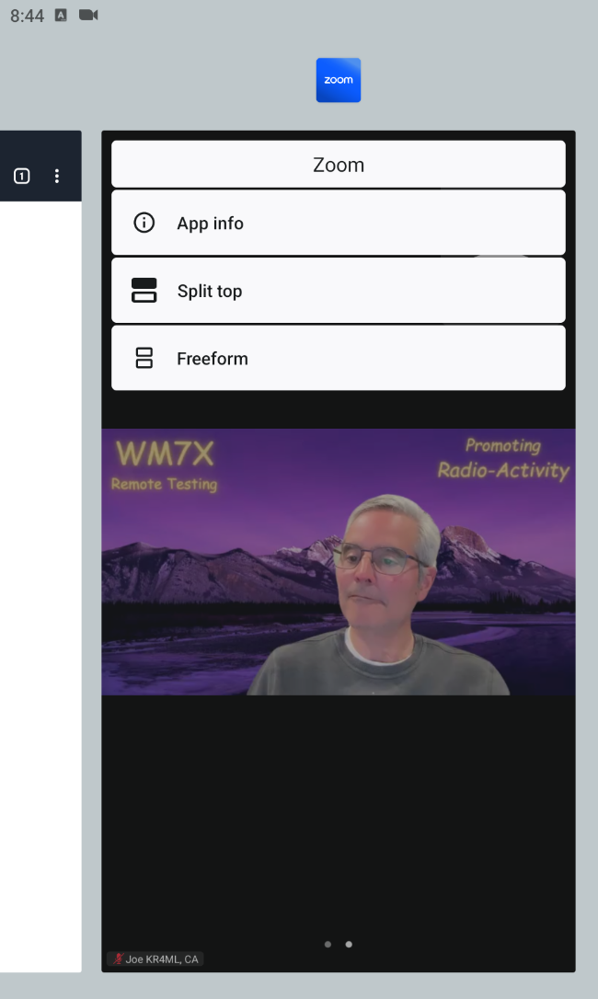
Android: Split Screen (1/2)
Launch their browser of choice
Tap the three-line icon to go back to the switcher (or swipe up on the gesture bar)
Tap and hold the Zoom icon, then Split Top
  In some versions, tap and hold the Zoom icon and drop it on the top half of the screen
Tap the browser to fill the bottom half

Slide 33
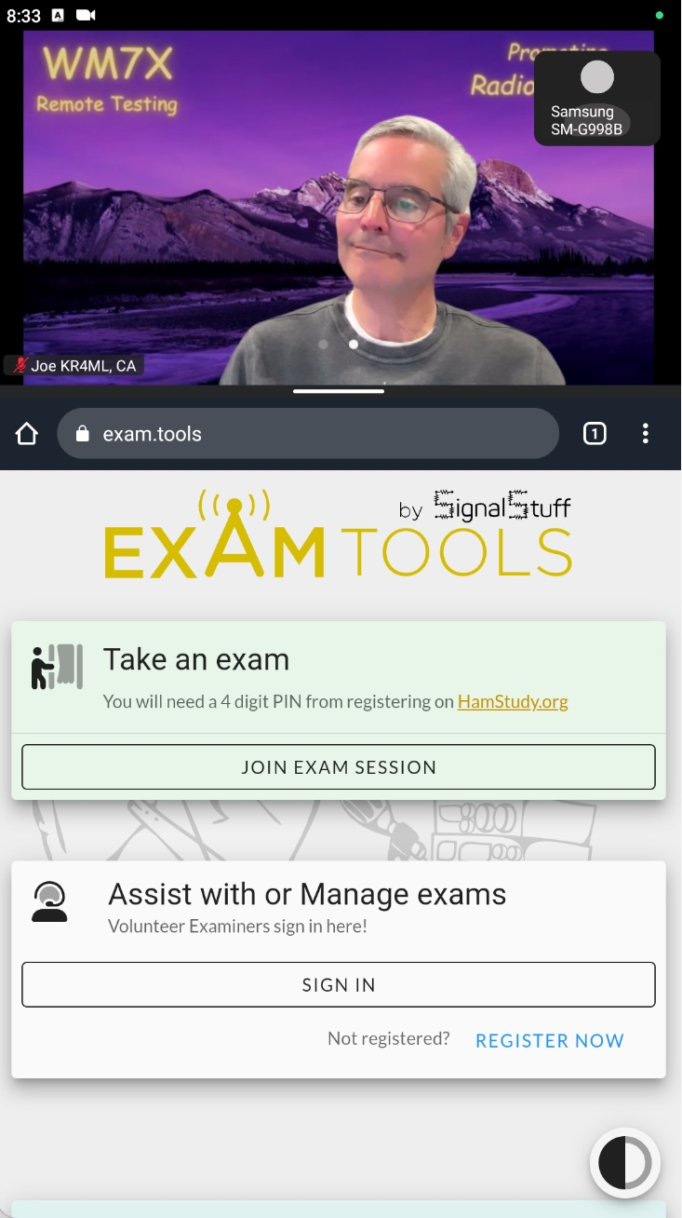
Android: Split Screen (2/2)
Adjust the divider between the top and bottom so the Zoom portion is about a third of the display
Be sure not to make zoom so small that it disappears
Continue to Browser Setup

Slide 34
Linux: Start Sharing
Zoom in the browser: Be sure not to close the Zoom tab!
Press the green Share button with up arrow at
the bottom of Zoom tab
Now Press the blue Share button at the bottom
of the new window that just popped up

Slide 35
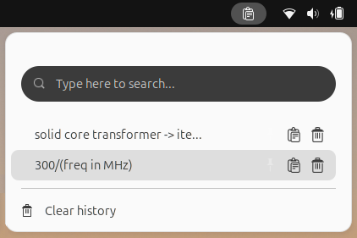
Linux – From the UI
Explore the items on the taskbar
  Check and clear clipboard history if present
  Check for a Caret to see what it reveals
  Close apps other than Zoom and the browser

Slide 36
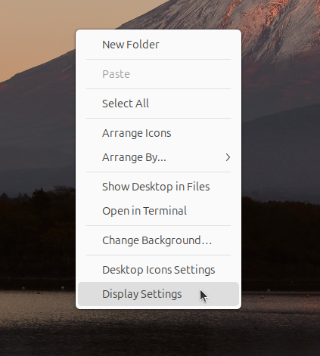
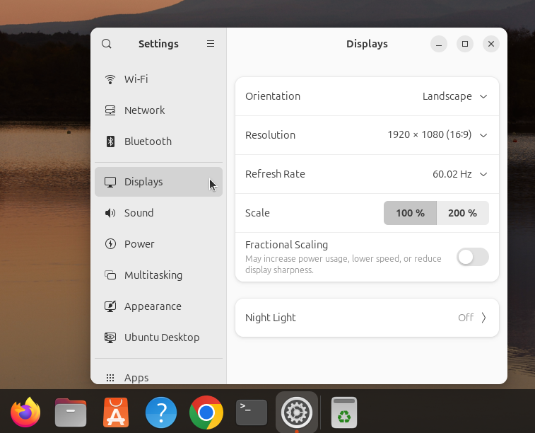
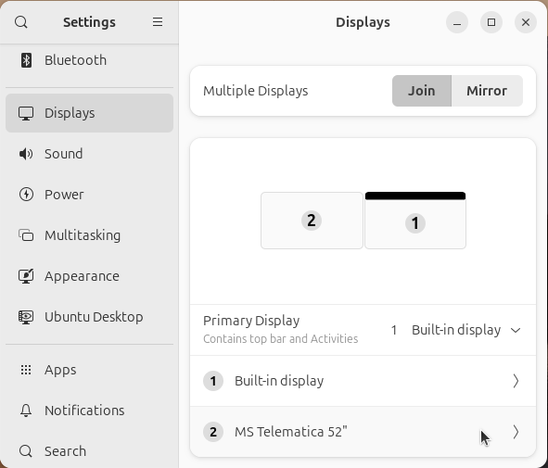
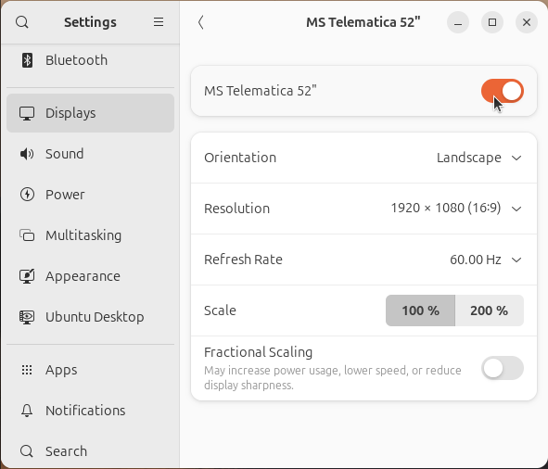
Linux – Multiple Displays
Open Display Settings
  Right click on the desktop and click Display Settings
  or
  Open the Settings App, then choose Displays
  If multiple displays are shown, disable all but one
Right click desktop or
Open Settings App
Check for multiple displays
Disable other displays

Slide 37
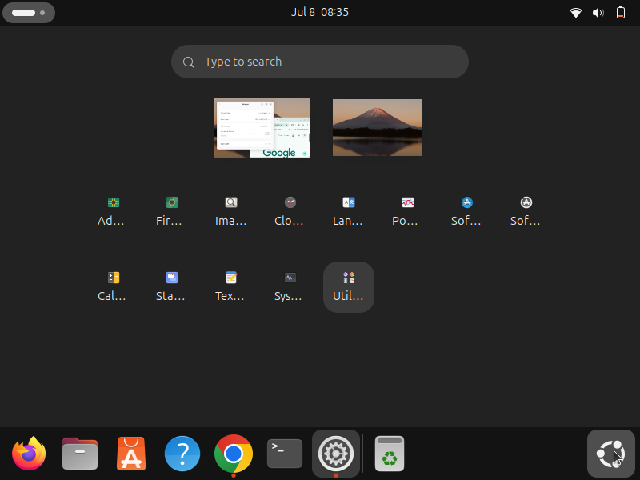

Linux – Multiple Desktops
Click the App Launcher and look for multiple desktops at the top
If that doesn’t work, check for desktop icons in the taskbar
There may be empty desktops that you can’t close. It’s OK as long as they are empty.
Look for “Workspaces” in Settings/Prefs
No luck? Try using keyboard shortcuts
Otherwise, Continue to Terminal commands
App Launcher
or
Desktop icons

Slide 38
Linux – Multiple Desktop hot-keys
Common Distributions and Desktop Environments
Desktop Environment | Show Workspaces / Overview | Switch Workspaces
GNOME (Fedora, Debian, Ubuntu) | Super (Windows key) | Super + PgUp / PgDn
KDE (Kubuntu) | Check for taskbar icons | Ctrl + F1 to Ctrl + F8
Cinnamon (Linux Mint) | Ctrl + Alt + ↑ | Ctrl + Alt + ← / →
Xfce | Check for taskbar icons | Ctrl + Alt + ← / →
MATE | Check for taskbar icons | Ctrl + Alt + ← / →
LXQt / LXDE | Check for taskbar icons | Ctrl + Alt + ← / →

Slide 39
Linux – From a Terminal
Ask the user to open a Terminal (aka shell window)
Have them type each of the commands below and hit Enter
  They must type the commands exactly as shown
  Check that the out is as expected
COMMAND
$ systemd-detect-virt
$ who
EXPECTED OUTPUT
detects virtual machine. Should say “none”
Look for more than 1 user logged in
Continue to Browser Setup

Slide 40
Windows: Start Sharing
Press the green Share button with up arrow at
the bottom of Zoom window
  If they don’t see it, they might have to click on the zoom
  window to make it appear
Now Press the blue Share button at the bottom
of the new window that just popped up

Slide 41
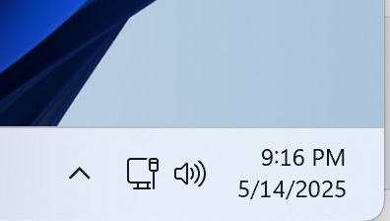
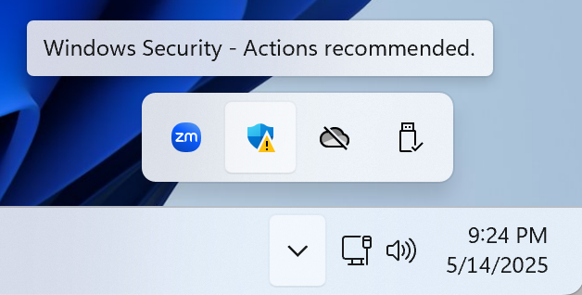

Windows: Hidden Apps
Click the Caret on right of taskbar to expose hidden icons
  If no Caret, inspect icons to the left of the windows clock
Hover over each, close if needed
  Right Click & Close/Quit/Exit

Slide 42
Windows: Displays & Desktops
Hold down the WINDOWS key and press P
  Select PC screen only
    Uses only the primary monitor; external displays are ignored
  ESC to return to normal view
Hold down the WINDOWS key and press TAB
  Check for one desktop, no stary apps, close as needed
  Quit apps other than Zoom and the Browser
  ESC to return to normal view
Notes:
By confirming your display setup first (Win + P), you ensure there is truly only one active screen—so no windows are lurking off-screen on a hidden monitor. Once you’ve locked down the physical display to “PC screen only,” hitting Win + Tab reliably reveals every open window and virtual desktop on that single display. This order prevents any off-screen or “second-monitor” app from slipping by your inspection.

Slide 43
Browser Setup
Now let’s go to the browser of your choice
If there is a tab titled Zoom – Amateur Radio Exam
  Close all other tabs
  Scroll to the frog and click it
else
  Close all but one tab and type exam.tools in the address bar
Note: If they’re having trouble getting to the tabs on PC or Mac, the Zoom share controls may be in the way. Move the controls or the browser.

Slide 44
Enter the exam
You’re here to Take an Exam, so just click JOIN EXAM SESSION
Now you can enter WM7X for the team identifier, and…
NNNN as your PIN (next to their Zoom name & in exam.tools)
Now click JOIN SESSION
Use exam.tools to admit the candidate…
  then ASSIGN TO ME in exam.tools

Slide 45
Check Info and Launch Exam
Ask to check their info
If you hit Start Exam, VE1 will generate a test for you…
Before you jump in, I’ll give you a few instructions
And when your done VE2 will grade it

Slide 46

Explain the exam UI / Process
It’s a simple interface…
  One long page, scroll up and down at will
  Click on an answer to choose it, or press the corresponding letter
  You might see a diagram…
  If you need a calculator, click the icon at the top left of the browser
  You can go back and change answers if you’d like, right up until you…
  Hit the GRADE EXAM button, and VE2 will get it graded

Slide 47
Ask them to start
Any questions?
OK, please leave your audio and video on…
We’re going to mute ourselves, so we don’t disturb you
GOOD LUCK and we’ll see you on the other side!!

Slide 48
After the exam
Wait for VE2 to check the exam; prompt them if they forget
  26 required to pass, 37 for Extra
Normal Case (first element attempted):
  Passed or Fell short by a lot or Fell short by a little
Second/Third level attempted:
  Passed: Awesome!! Continue
  Failed: No worries, you can come back for that upgrade once you’ve had a little more time to study. Continue

Slide 49
Fell short by a lot
Provide words of encouragement
  You can take the exam again when you’re ready
  Refer to HamStudy.org, see all the questions, shoot for 85%
Leave after falling short

Slide 50
Fell short by a little
You were very close! You’ll definitely get through this.
Do you want to take the exam again right now?
Yes: (They will have to pay again to retest after falling short)
  If the waiting room is super busy, they may need to wait, otherwise…
  Press the Start Exam button
  Back to the exam process
No:
  Leave after falling short

Slide 51

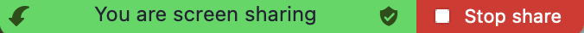

Leave after falling short
To leave the meeting
  Press the back arrow with the bracket icon
  at top of browser window
  Stop sharing
  Leave the meeting
On phone
In Zoom App

Slide 52
Passed the exam
CONGRATULATIONS!
Technician / General: 36th question
  Have you prepared for, and are you ready to pass the General / Extra exam?
  Yes or No

Slide 53
Wants to take next exam
Terrific, just press the START EXAM button
  [It will be GENERAL or EXTRA]
Start the exam process again
Note: No charge to take additional exams after passing

Slide 54
Start the paperwork
The hard part is done, now we do the paperwork
Just press FINISH AND SIGN FORMS, then FINISH AND SIGN
Ask to check the information on the screen again
Click Quick Form 605
  Check data yet again
  Ask them to review the 6 bullet points under “I certify that”
  Hit CLOSE in the bottom right corner

Slide 55
CSCE
Now click on the blue bar that says CSCE
  Certificate of Successful Completion of Exam
  Ask to check the information on the screen one last time
  Click CLOSE when done
You’ll get a copy of this in 10-15 minutes
  It will have our signatures and yours
  Keep it in a safe place - it’s your proof that you passed the test

Slide 56
More Signatures
Review the four bullet points about your digital signature
Ask to type full name below the red text
Ask to mouse their signature
Press Sign Documents, Finish Session, Log Out
Stop sharing
Initial License or Upgrade
Mac or PC
iOS/Android
In Zoom App

Slide 57
Final Instructions: Technician
You’ve done it! Welcome to the airwaves
Email coming from FCC based on time and business day
Pay using a desktop / laptop – not a mobile device
You’ll be given the option to review your application – don’t
Another email with your callsign assignment should arrive in the next couple of business days following your payment
Instructions to leave meeting

Slide 58
Final Instructions: General / Extra
You’ve done it! Welcome to [ HF | the full bands ]
As soon as you get your CSCE you can start using your new privileges…
Just append [/AG | /AE] to your callsign (awaiting General/Extra)
You probably won’t get an email from the FCC…
  Check the ULS Database
  Once you see it, you can stop using [ /AG | /AE ]
Note: If changing their callsign, they will get an email

Slide 59
Leaving the meeting
On the 2nd device
  Leave Room, Leave Meeting (or host may remove the phone)
Passed:
  Technician or General: Please be sure to come back and see us when you want to upgrade
  The team is waiting to congratulate you
Leave Room, Leave Breakout Room

Slide 60
Finalize
Get thumbs up from all team members
Ensure recordings have stopped
Get three signatures
Go back to main room
Back to Start

Slide 61
Exiting an Applicant
Instructions for leaving the main room

Slide 62
Exiting an Applicant: Options
Initial Exam (even if multiple elements were passed)
Upgrade – keeping callsign (common)
Upgrade – changing callsign (less common)

Slide 63
Exiting: Initial Exam
Congratulations – Welcome to Amateur Radio!
Email from FCC <when>
  Pay from a desktop/laptop…
  Don’t touch your application form…
  Pay by 5pm on a business day…
  If you don’t see it by…
Thanks and we hope to see you again for your upgrade
Go celebrate!
Exit the Zoom meeting…
Back to TOC

Slide 64
Exiting: Upgrade (changing callsign)
Congratulations – Welcome to [HF | the Extra bands]!
Since you are changing your callsign…
  You’ll get an email from the FCC <when>
  Until then, use [/AG | /AE]
Thanks for testing with us
General: We hope to see you again for your upgrade
Go celebrate!
Exit the Zoom meeting…
Back to TOC

Slide 65
Exiting: Upgrade (keeping callsign)
Congratulations – Welcome to [HF | the Extra bands]!
No Email from FCC
  Check the ULS starting <when>
  Once you see your upgrade, stop using [/AG | /AE]
Thanks for testing with us
General: We hope to see you again for your upgrade
Go celebrate!
Exit the Zoom meeting…
Back to TOC

Slide 66
General Notes
Things to keep in mind

Slide 67
General Notes and Reminders
Read the Lead document and Android Document
“Let the leader lead” means the leader must keep things under control and keep the session flowing
Avoid distractions, stay engaged
Avoid saying “failed”. If necessary, use “fell a little short”
Give/get verbal responses from the team or thumbs-up in some cases
Back to TOC

Slide 68
Recording
The Lead always does R1 which includes the gallery and the screen share (50/50 split). Recoding ends after the final thumbs-up from the team
R2 captures the screen share and the applicant (50/50 split). Recording ends after the user is done taking tests; i.e., when they press “Finish and Sign Forms”
R3 captures the 2nd device and the screen share (70% device, 30% screen share). Recording stops the same time as R2.
Back to TOC

Slide 69
Three options to stop 2nd Device audio
SIMPLE and UNIVERSAL Option:
  Ask the applicant to turn down the volume manually, then…
  Ask the applicant to mute Zoom
  Alternatively, the host can mute their second device
  There may still be a little feedback, but it is manageable
UNIVERSAL Option: Disconnect Audio
iPhone Only: Stop audio before it starts
Back to prepping the applicant

Slide 70
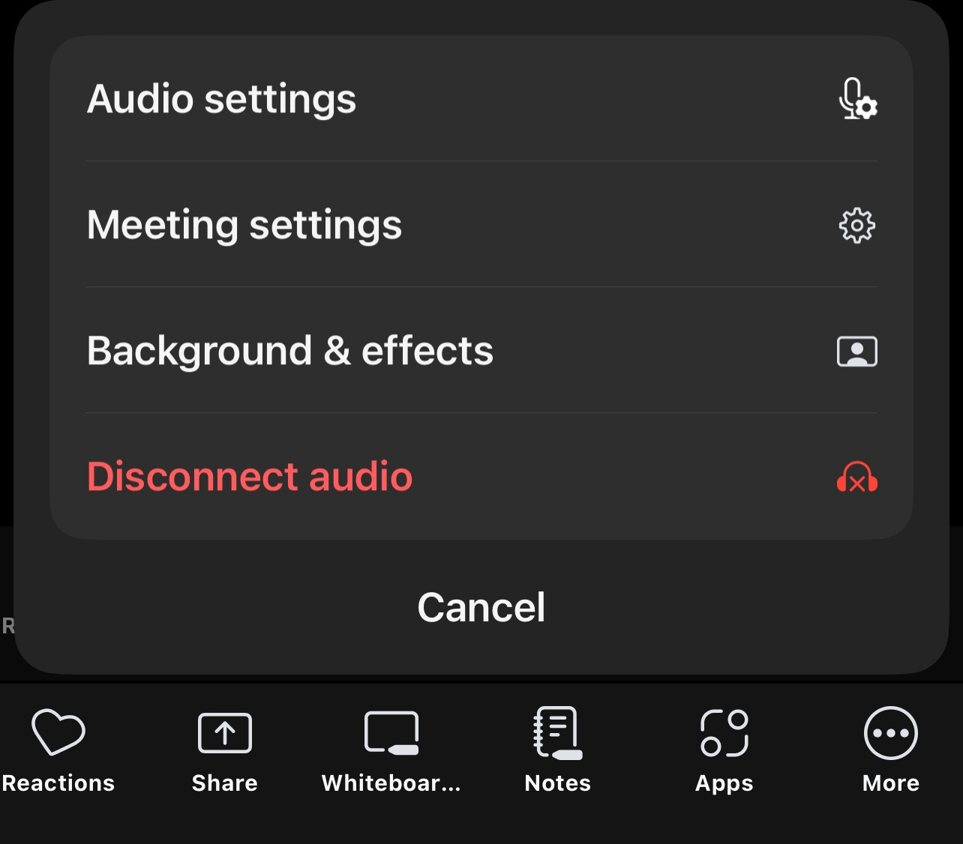
Stopping Audio on the 2nd Device
After the applicant has joined with their second device, they can disconnect audio
Tap the white More icon to bring up options
Find and tap Disconnect Audio
Back to prepping the applicant

Slide 71
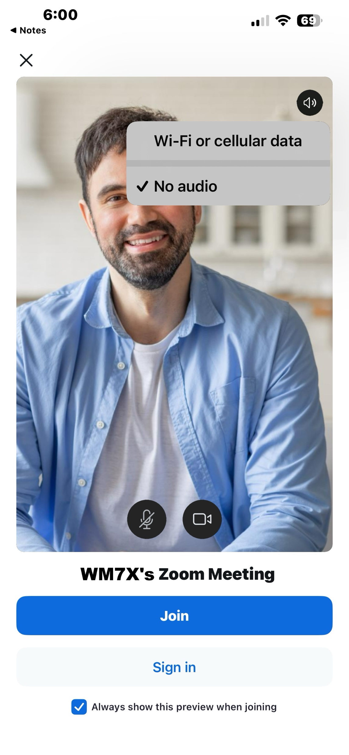
Stopping Audio Before it Starts (iPhone)
When the applicant is joining the meeting, they’ll see a speaker icon on Join screen
Tap the speaker icon to see options
Choose No Audio
Back to prepping the applicant

